Slide 1
Python Lists
DVT101 – Lecture 24
- By Dataverse Tutorials

Slide 2
Why Python Lists Matter
Lists store multiple values in one variable
Used in Data Science, ML, Web Apps
Dynamic and flexible structure
Supports indexing and iteration

Slide 3
Core Concept: What is a List?
Ordered collection
Mutable (can change)
Allows duplicates
Supports mixed data types

Slide 4
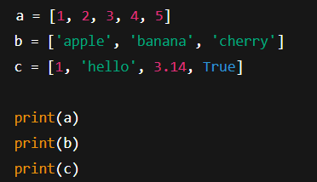
Creating Lists (Square Brackets)
Lists are created using square brackets []
Can store numbers, strings, mixed values
Order of elements is preserved
Lists are mutable (can be changed)

Slide 5
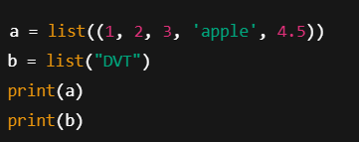
list() Constructor
list() converts iterable into list
Works with tuples, strings, ranges
Each character becomes an element when using string

Slide 6
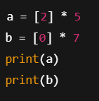
Repeating Lists
* operator repeats list items
Useful for initializing values
Creates new list, not reference copy

Slide 7
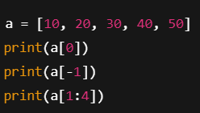
Indexing & Slicing
Index starts from 0
Negative index reads from end
Slicing extracts a sub-list

Slide 8
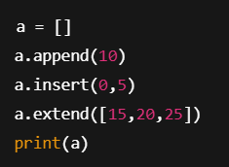
Adding Elements
append(): add one element at end
insert(): add at specific position
extend(): add multiple items
clear(): removes all items

Slide 9
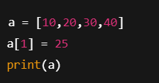
Updating List
Lists are mutable
Elements can be replaced by index
No need to create new list

Slide 10
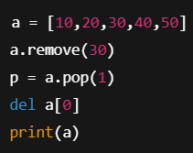
Removing Elements
remove(): deletes by value
pop(): deletes by index
del: deletes by position

Slide 11

Iteration
for loop reads items one by one
Useful for processing each element

Slide 12

Nested Lists
List inside another list
Used for matrices, tables
Access using two indexes

Slide 13

List Comprehension
Short way to create list
Applies logic in one line
Faster and readable

Slide 14
How Python Stores Lists
List stores references
Elements exist separately in memory
Mutable objects affect original memory

Slide 15


